Slide 1
Team Hackermen
Project: ticket salad

Slide 2
Table of Contents
Introduction
Description of the Project
Domain model of the Project
The outline of Requirements and design document
Package diagram
Deployment diagram

Slide 3
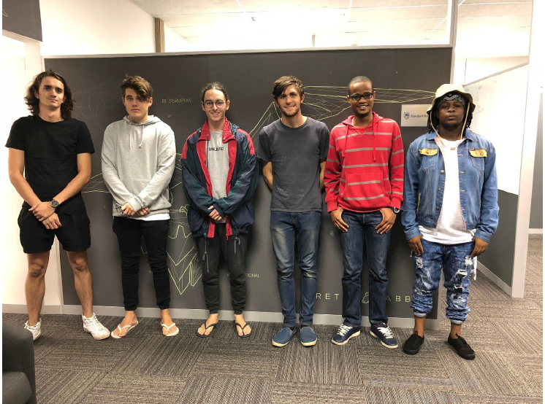
Introduction

Slide 4
A Brief Description of the Project
Ticket Salad is a mobile application that is competition based ,it also serves as an online store for events and holiday packages
The competition platform incorporated into the application allows users to get high-end tickets at extremely low rates.

Slide 5
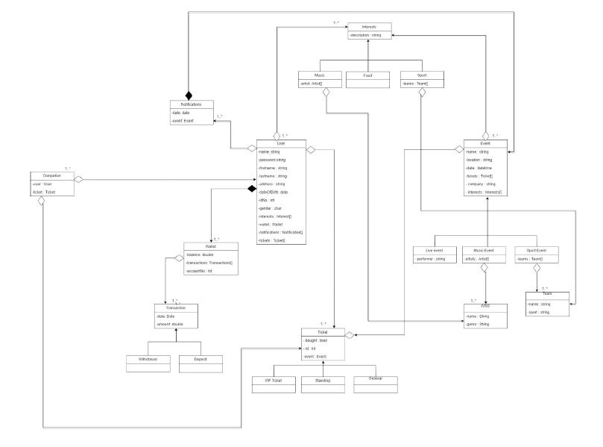
Domain Model of The Project

Slide 6
Outline of Requirements and Design Document

Slide 7
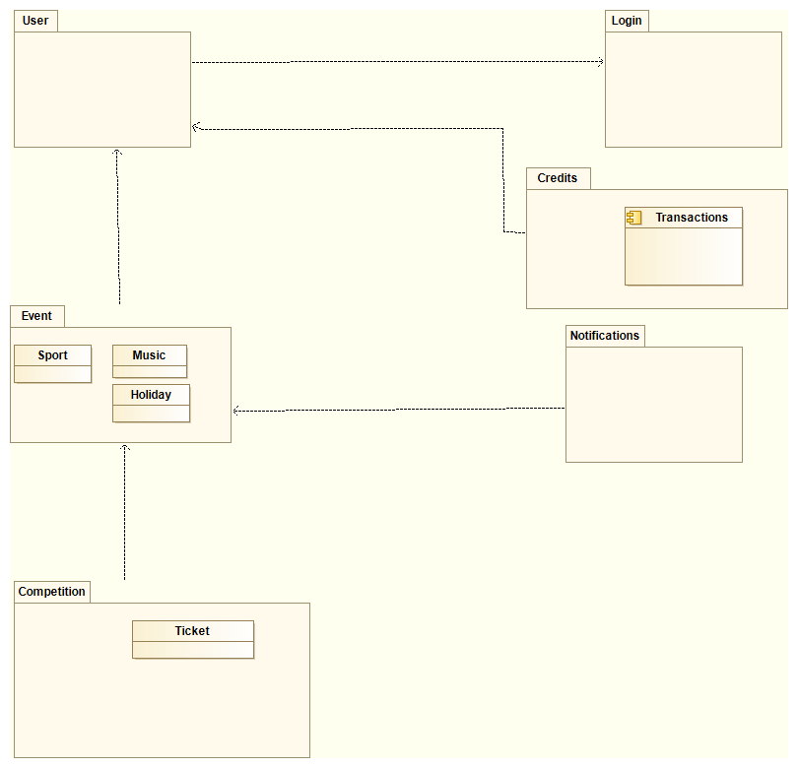
Package Diagram of your Project

Slide 8
Deployment Diagram

Slide 10
Add a Slide Title - 4

Slide 11
Add a Slide Title - 5

